Slide 1
Project 2 (Research ) – Sentiment Classification
Team Members:
Sreejith Menon (smenon8@uic.edu)
Rajan Bhandari (rbhand4@uic.edu)

Slide 2
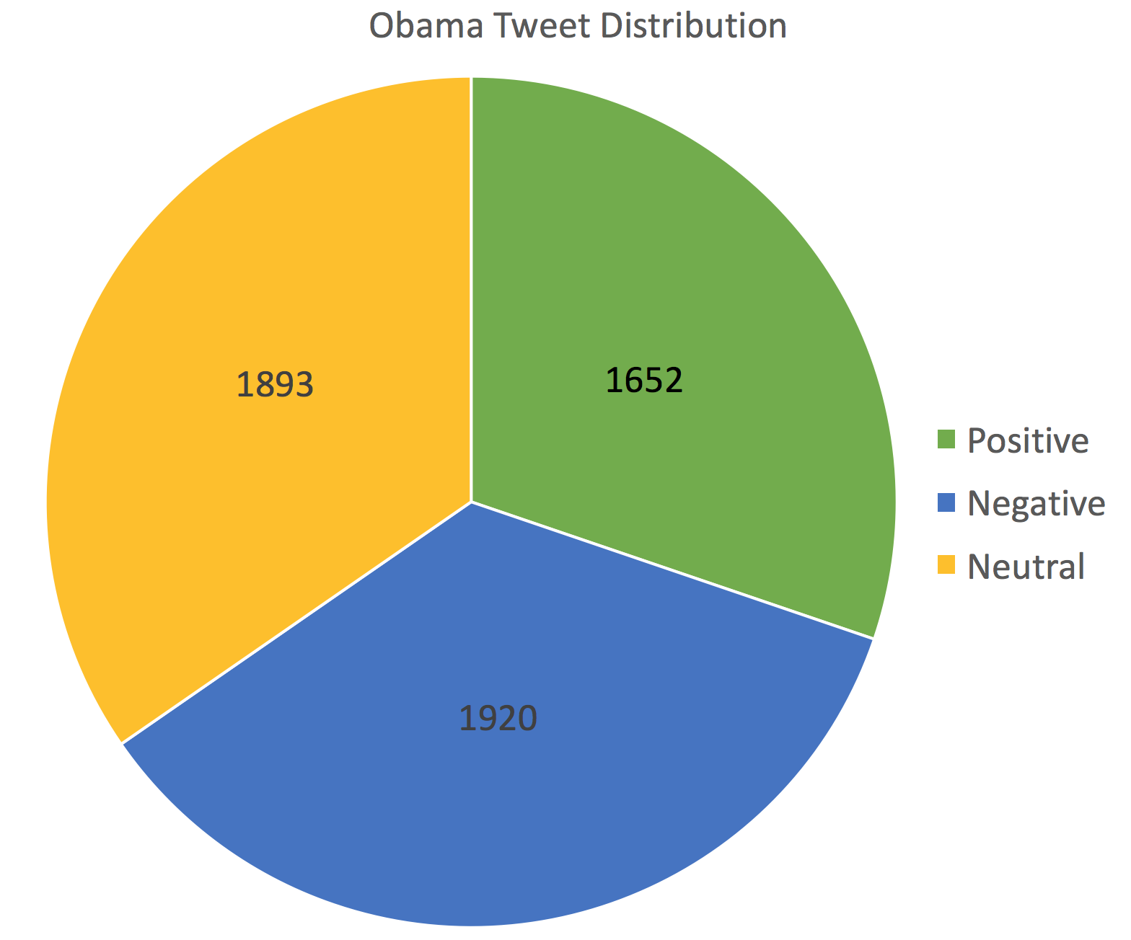
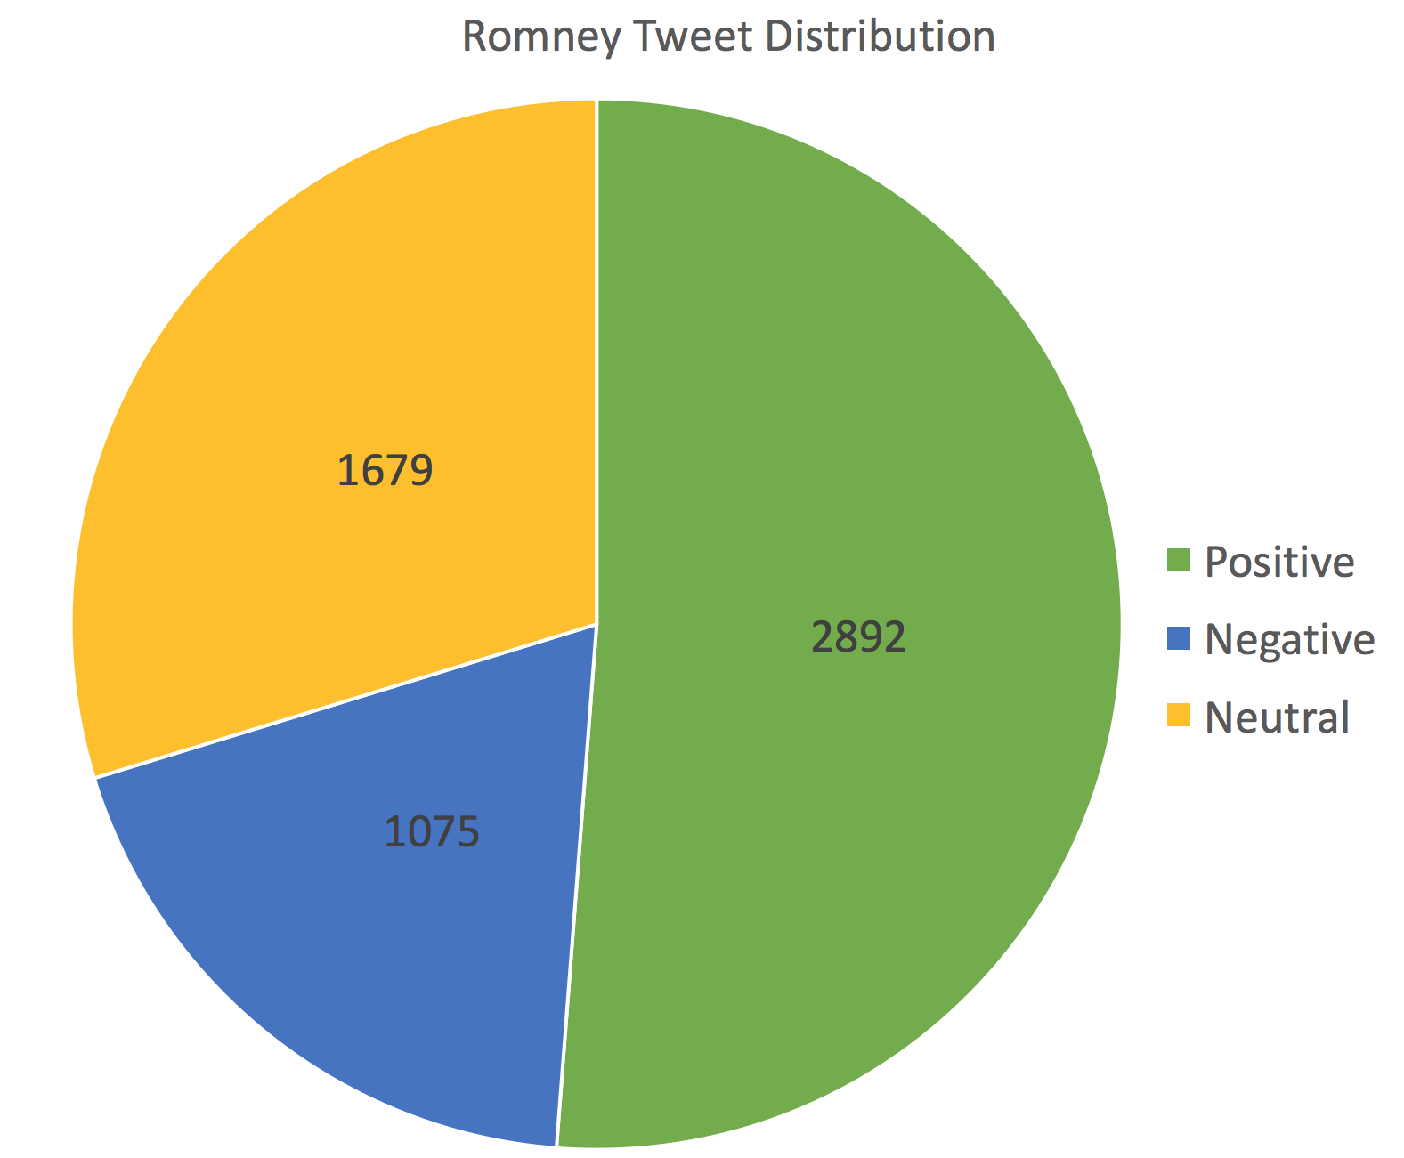
Data Preprocessing & Data Distribution
Data Cleaning
Removed html tags, hyperlinks, symbols (all non-alphanumeric characters)
Converted all texts to lowercase, removed tweets from mixed class
Removal of stop words (the, of, and, to…)
Data Distribution (post cleaning)
Converted the tweets to bag of words model (binary sequence transformation for each tweet)

Slide 3
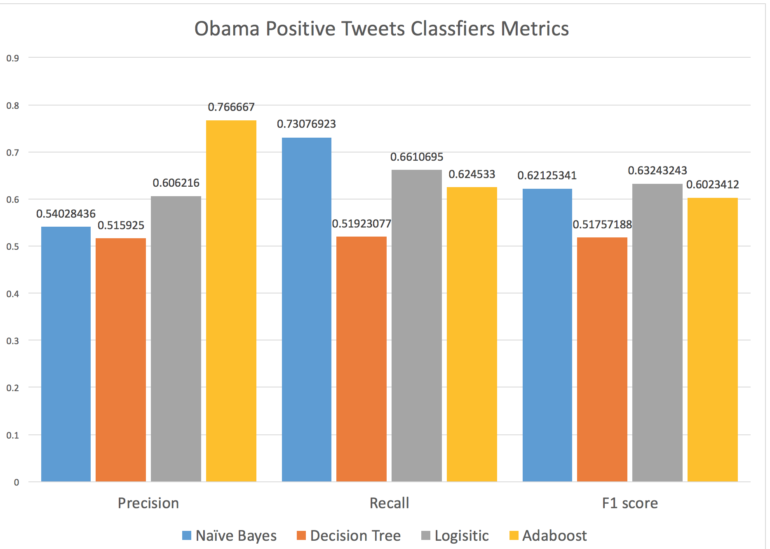
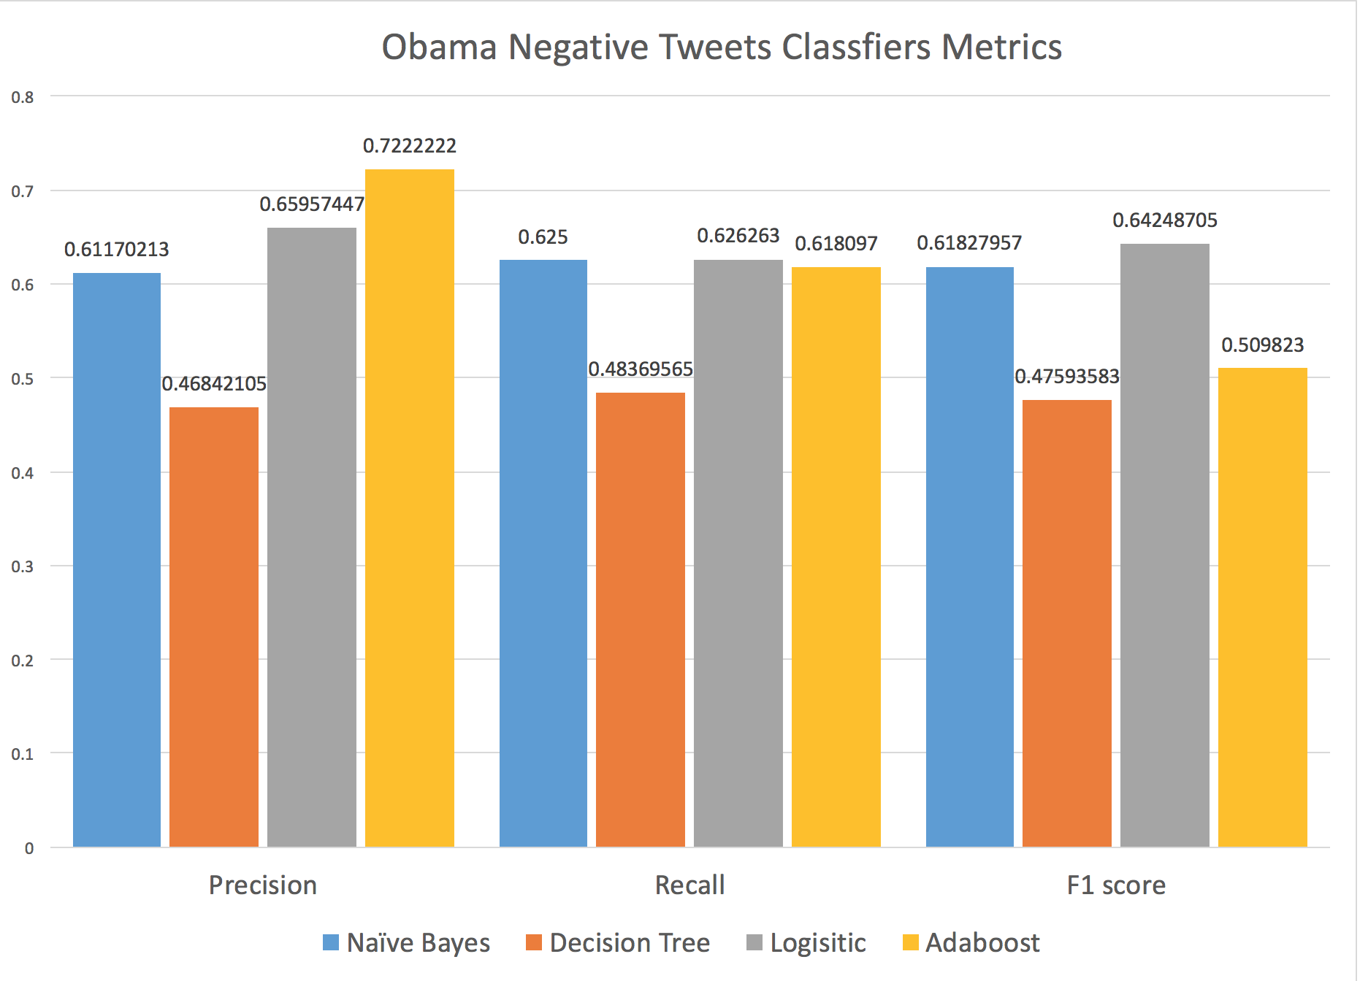
Classification Algorithms & Results - Obama
Old Results
Naïve Bayes: Overall Accuracy = 0.581352833
Decision Tree: Overall Accuracy = 0.49360146
New Results
Logistic: Overall Accuracy = 0.6014625288
AdaBoost: Overall Accuracy = 0.5252102376

Slide 4
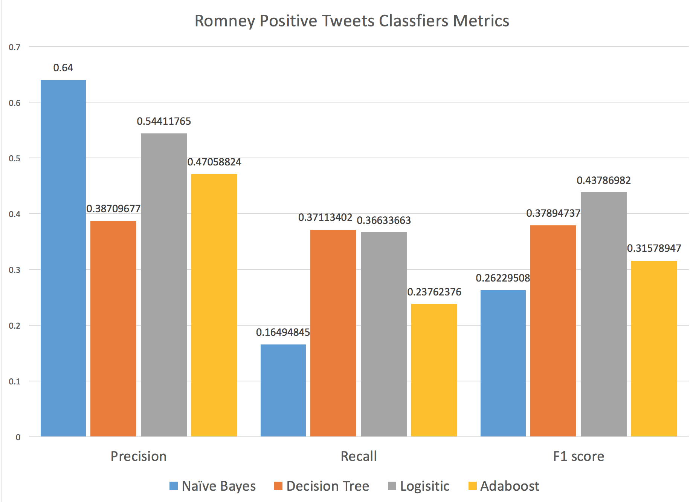
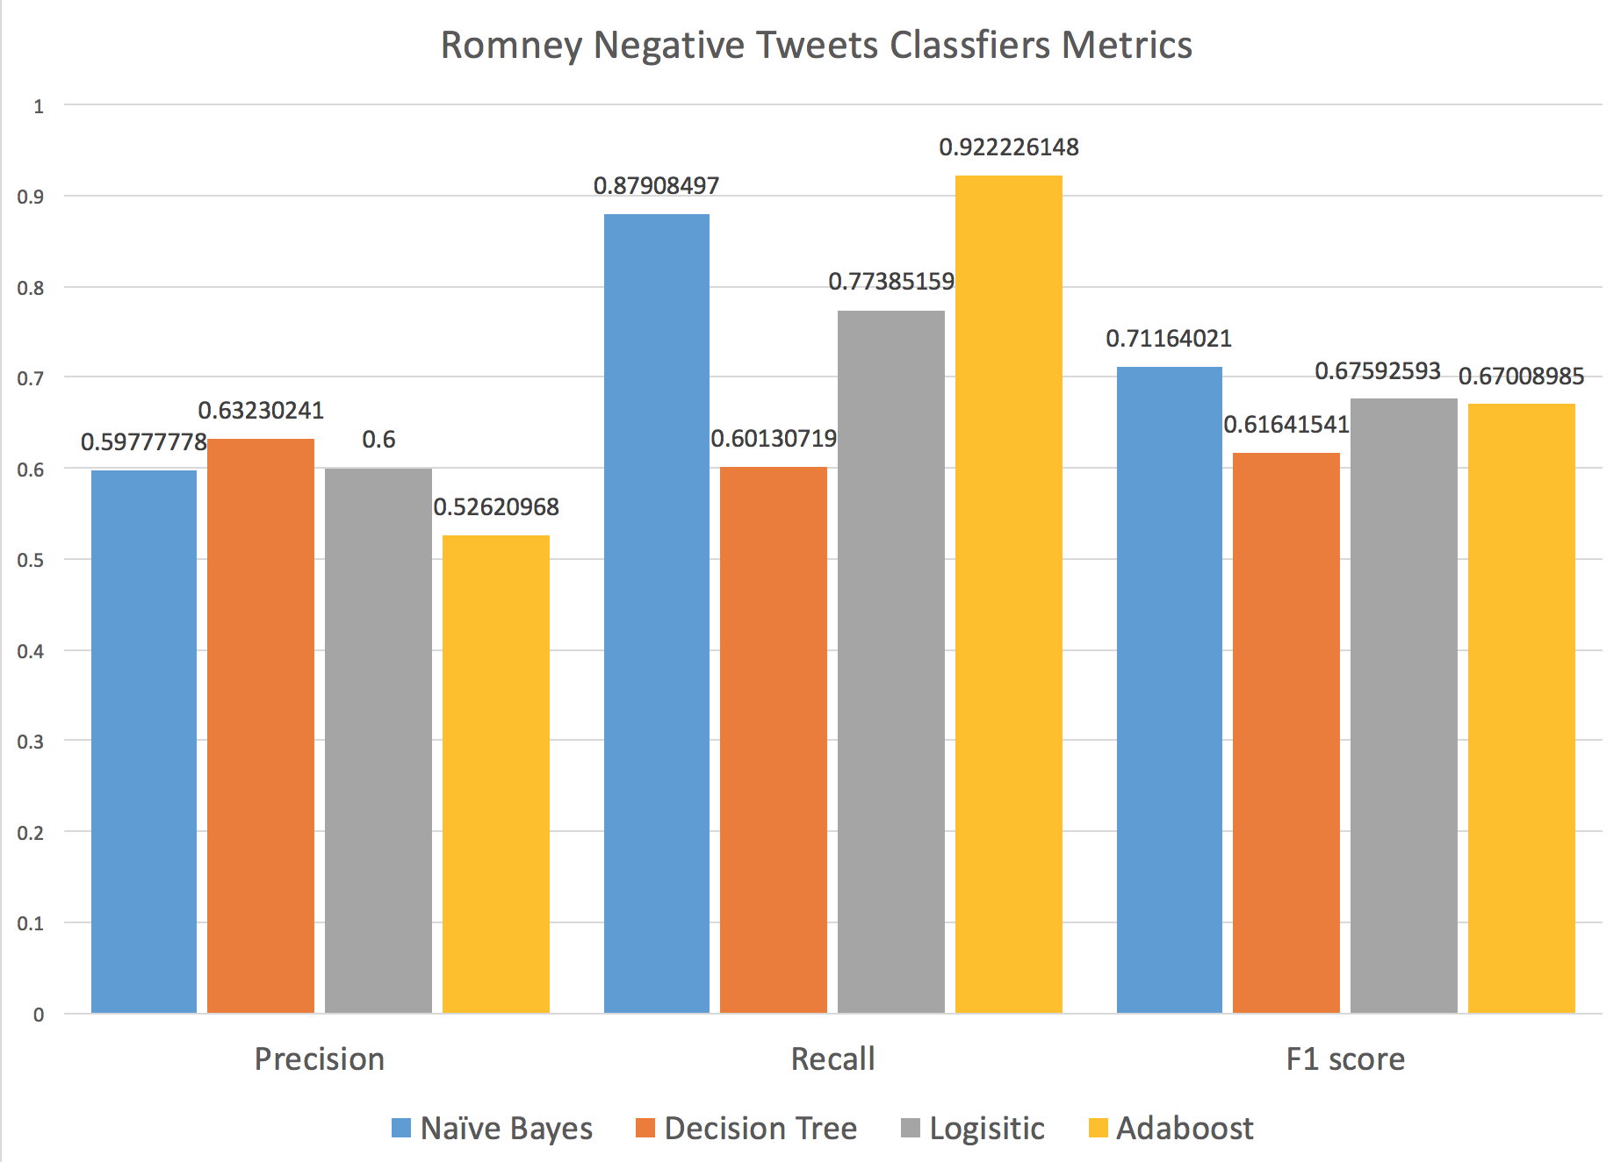
Classification Algorithms & Results - Romney
Old Results
Naïve Bayes: Overall Accuracy = 0.569911504
Decision Tree: Overall Accuracy = 0.513274336
New Results
Logistic: Overall Accuracy = 0.55044247787
AdaBoost: Overall Accuracy = 0.538398053

